Slide 2
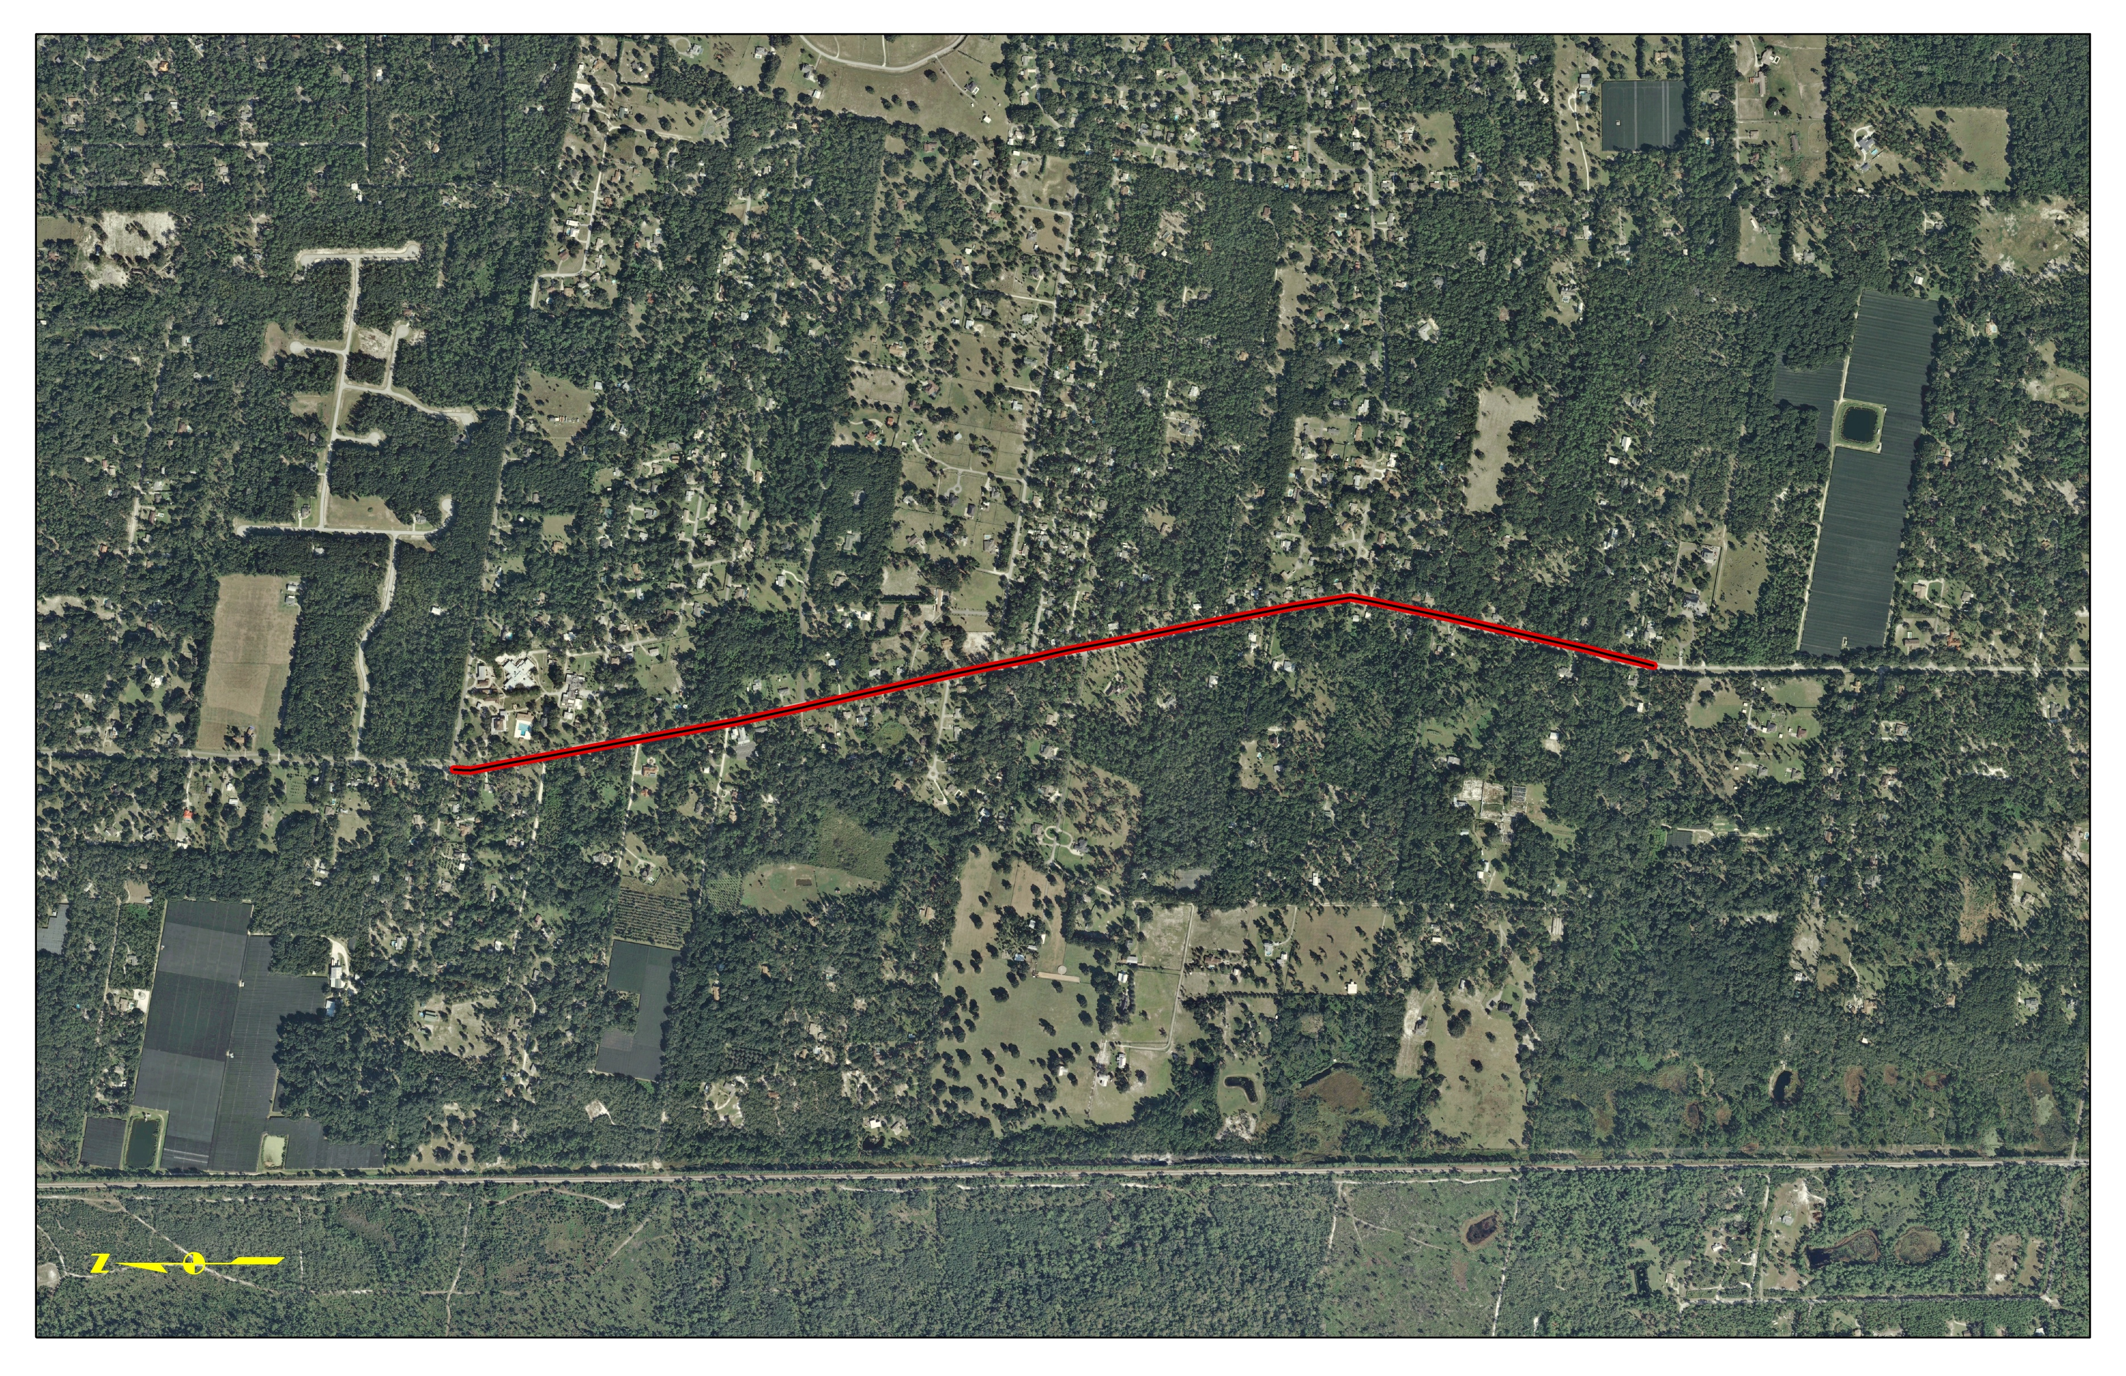
Spring To Spring Trail
Grand Av - Lemon St to King St
1.8 miles – Begins Late 2013
Existing Trail
Grand Av
Existing Trail
King St
Lemon St
CSX R/R

Slide 3
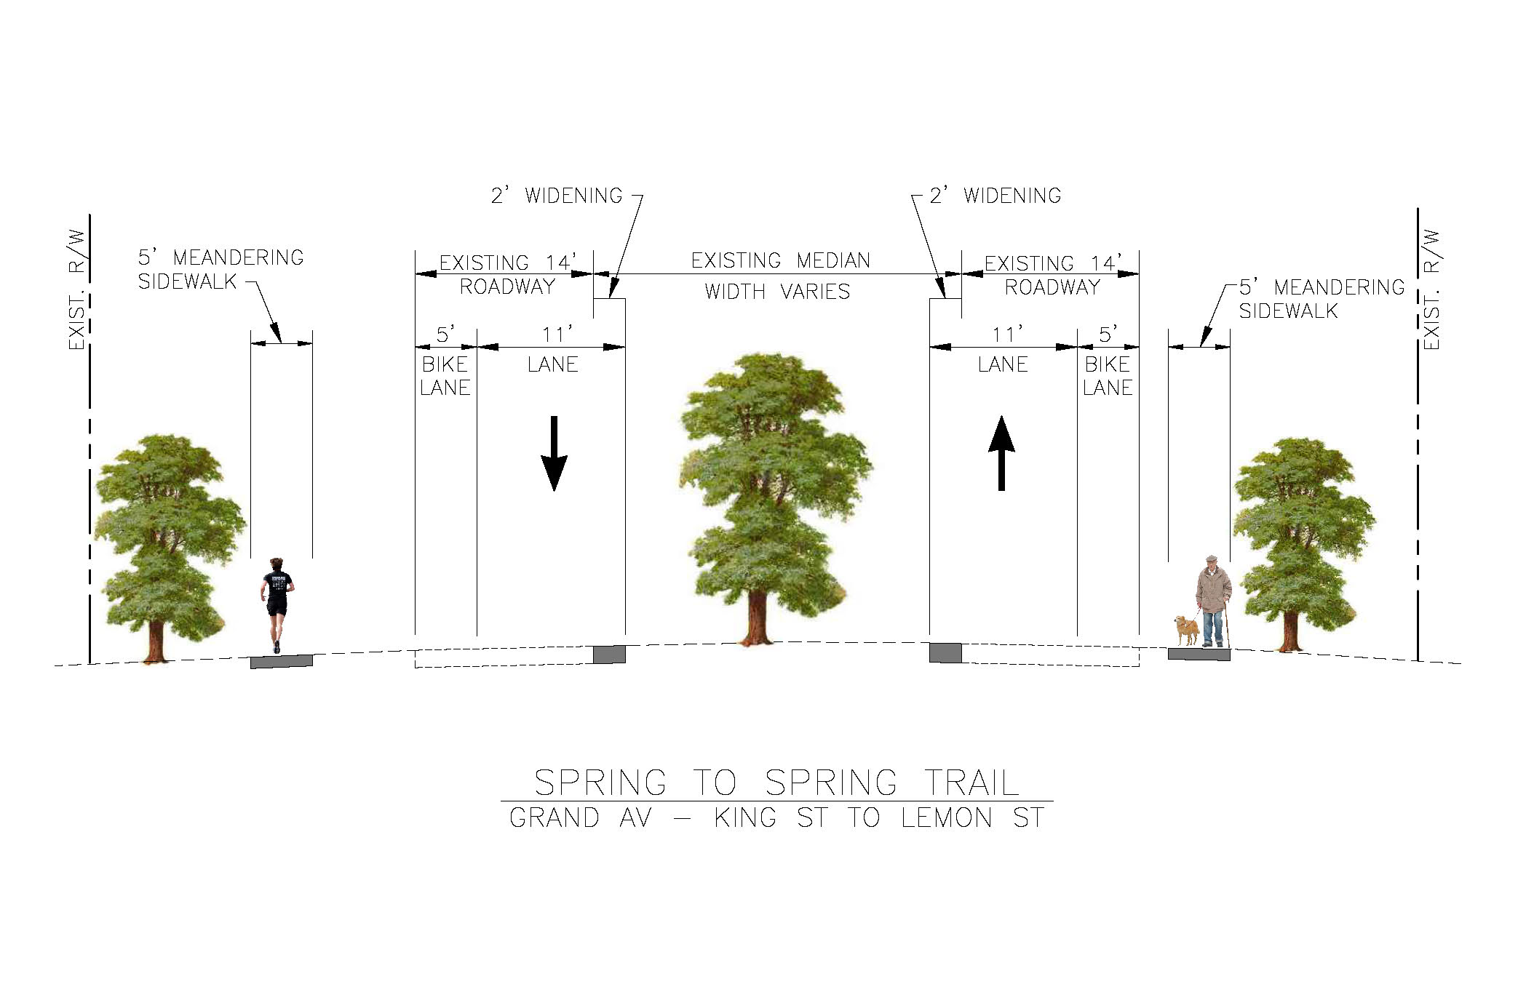

Slide 4
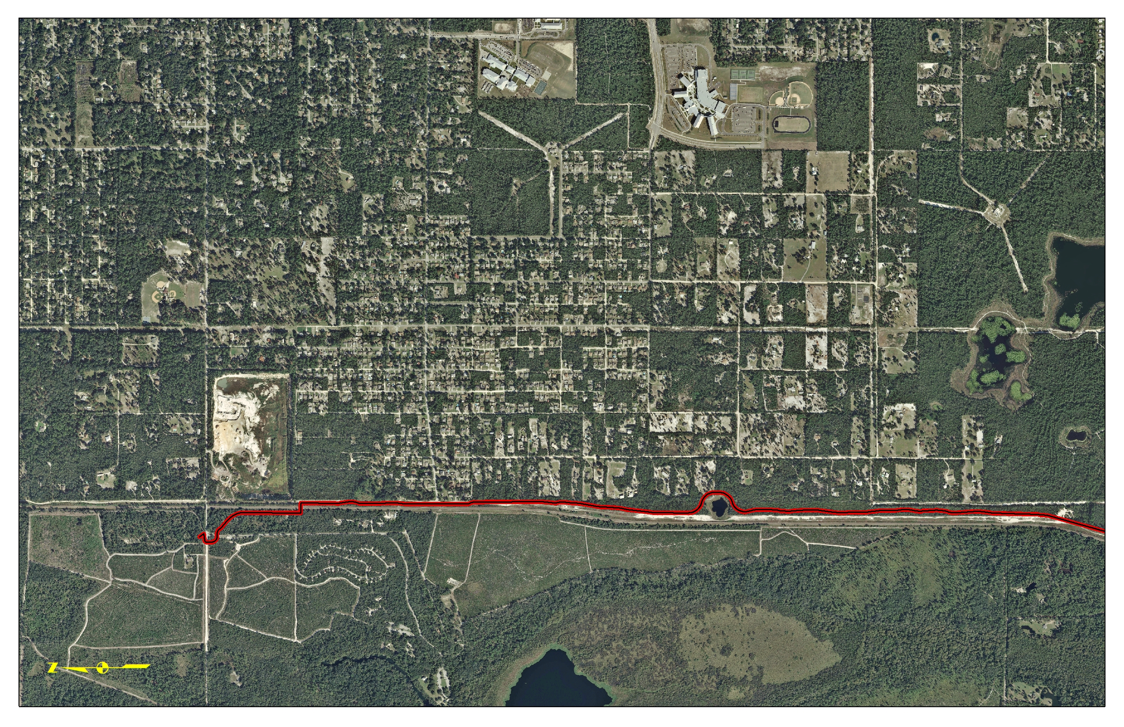
Spring To Spring Trail
French Avenue to Detroit Terrace
2.4 miles – Mid 2014
Valentine
Park
Springs Ave
French Ave
Trailhead/
Parking
Blue
Break Line
Existing Trail
SunRail
Tracks
Blue Spring State
Park Entrance
Steel Truss Bridge
Over SunRail
Ancient
Sinkhole
Detroit Ter

Slide 5
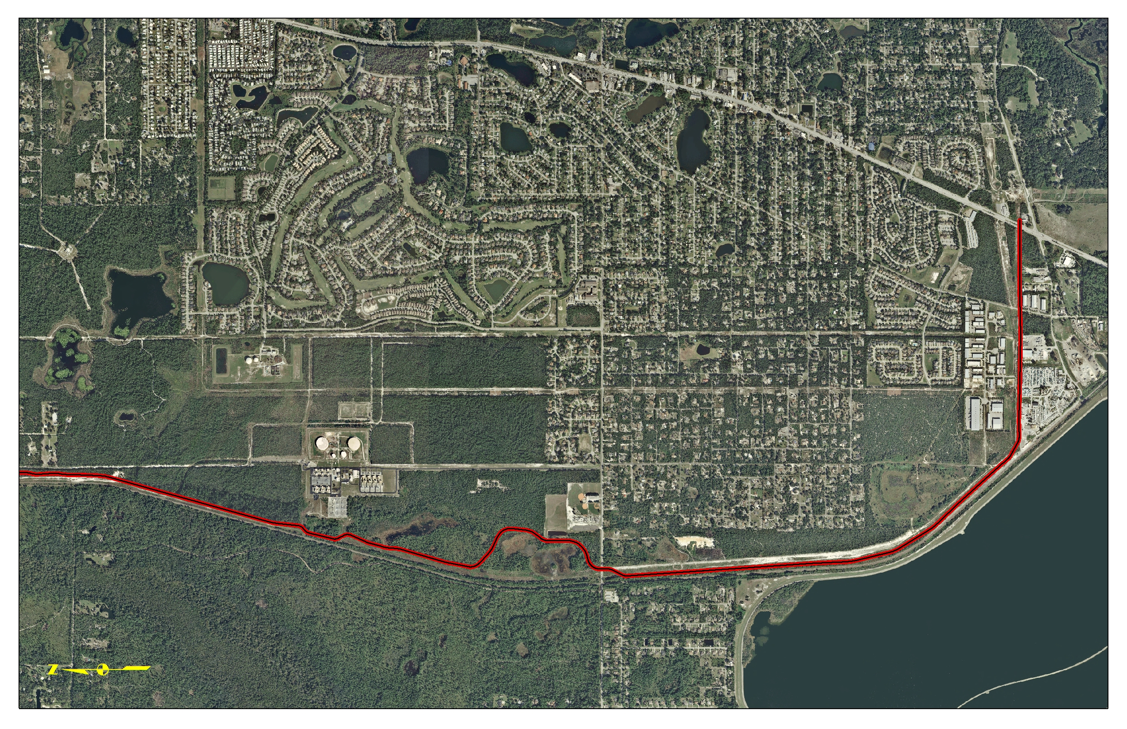
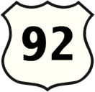
Spring To Spring Trail
Detroit Terrace to us 17/92
Existing
Trail
Gemini
Springs
Park
Dr
Dirksen
4.9 miles – Currently Unfunded
Donald Smith
Blvd
Rob Sullivan
Community Park
Break Line
Progress Energy
Plant
W Highbanks Av
Detroit Ter
KONOMAC
LAKE

Slide 6
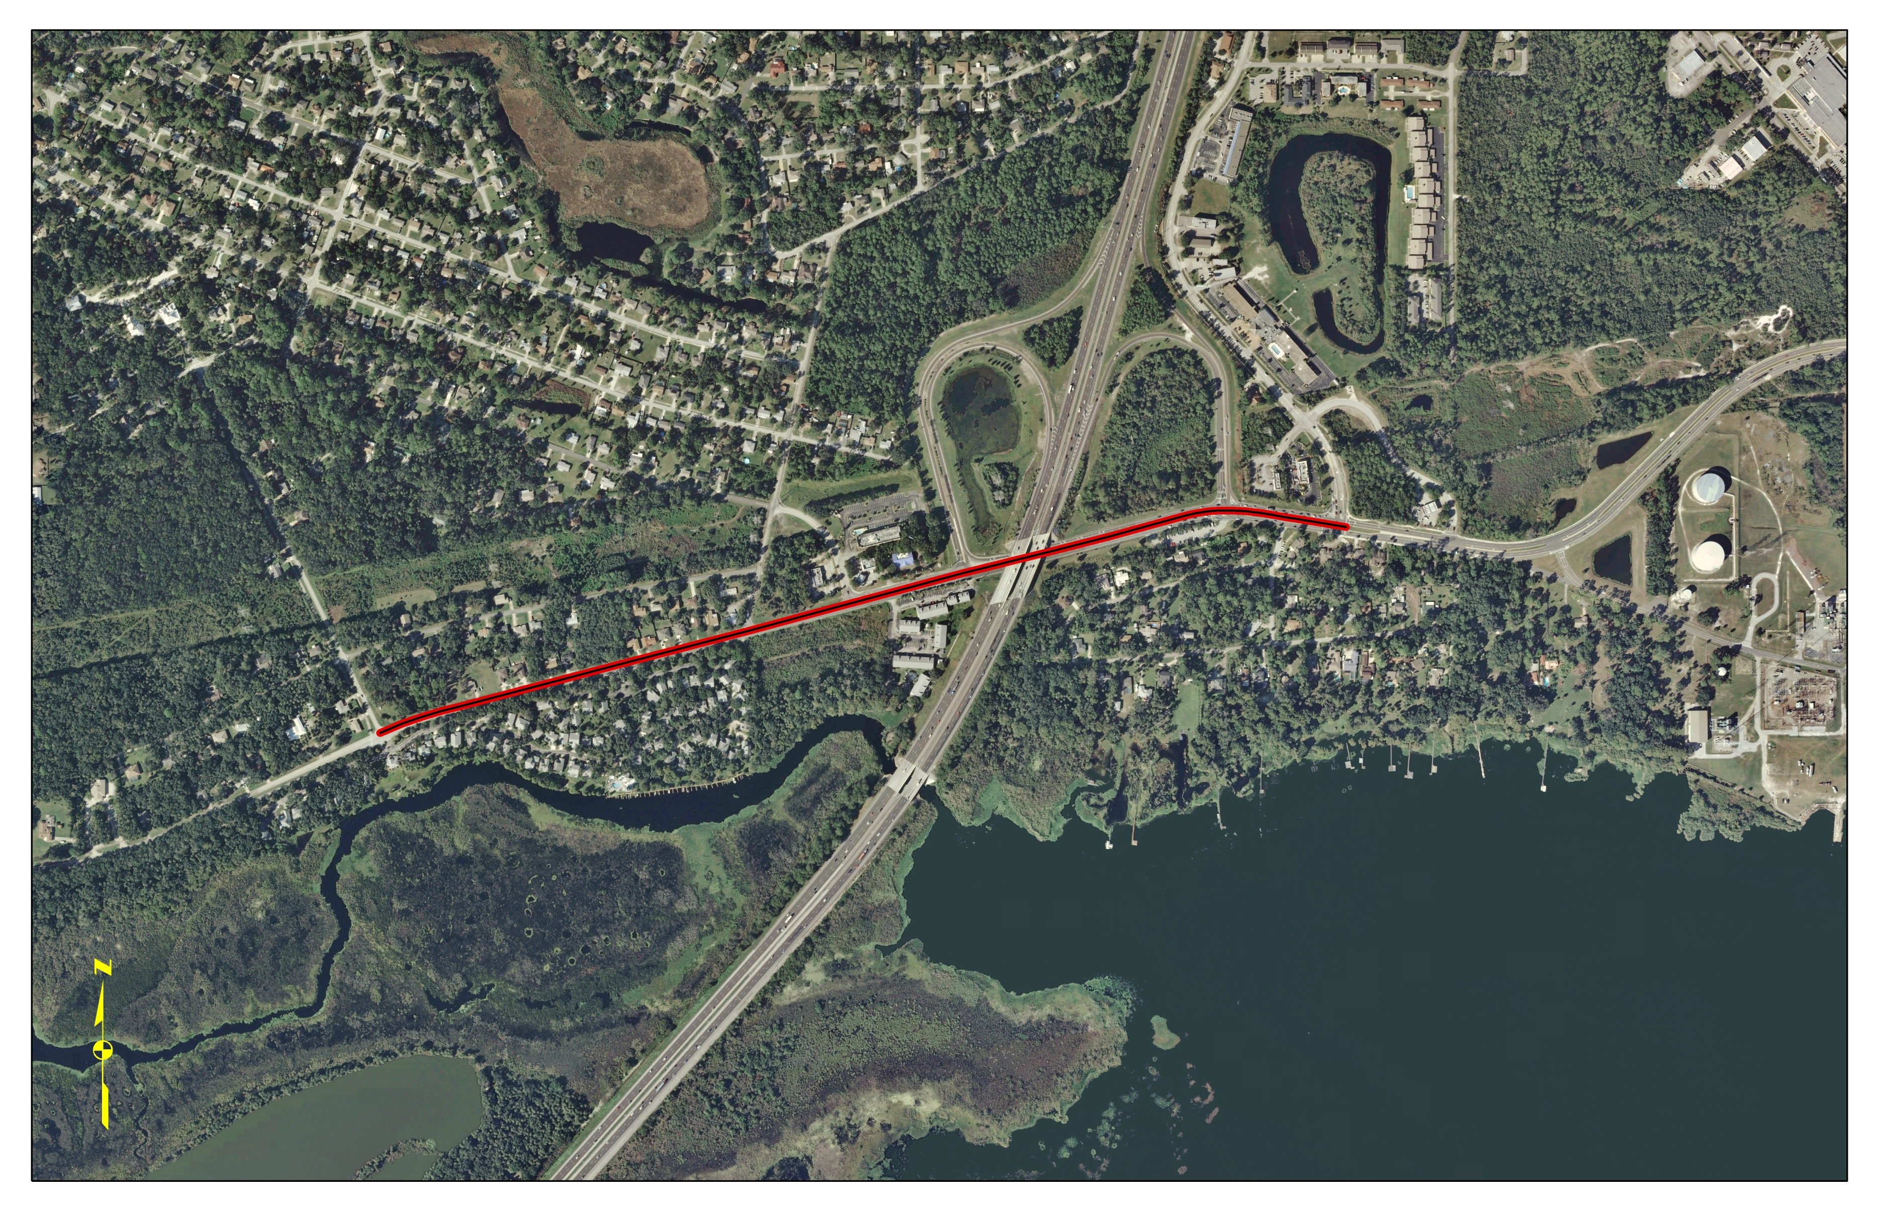
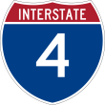
Spring To Spring Trail
Dirksen Dr – Mansion Blvd to Deltona Blvd
.9 miles – Late 2013
DeBary
Hall
Deltona Blvd
Debary Av
Existing
Trail
Existing
Trail
Dirksen Rd
Existing Trail
LAKE
MONROE

Slide 7
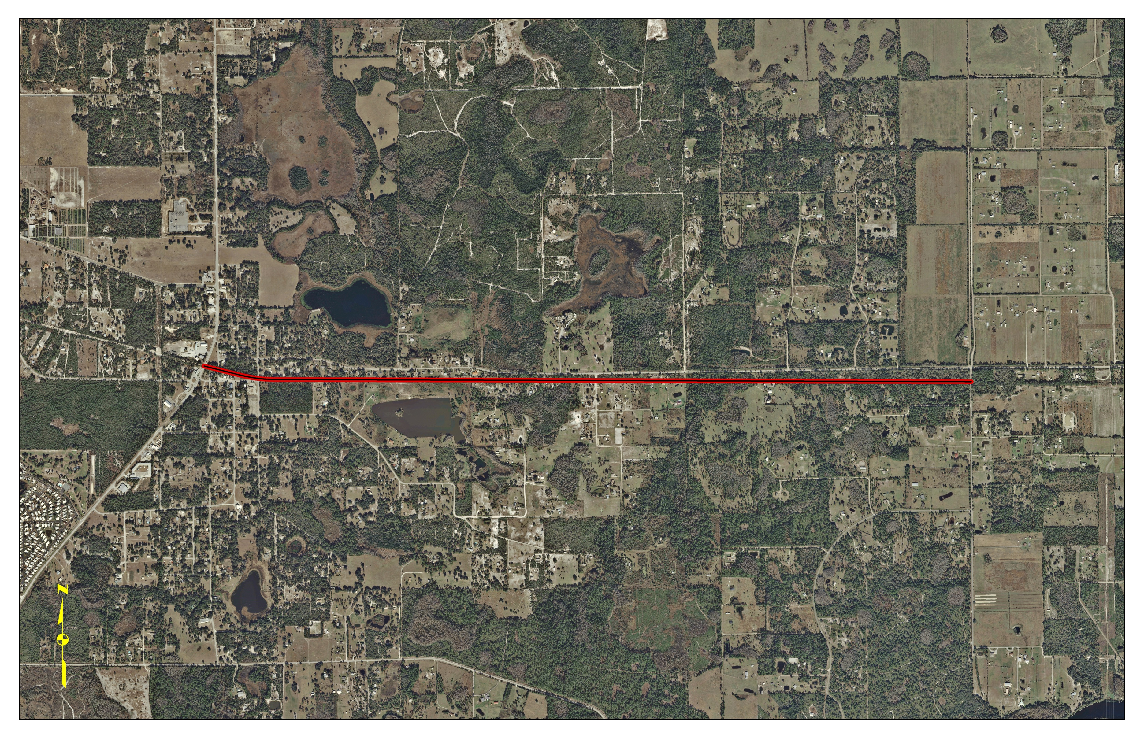
East Central Regional Rail Trail
Osteen Maytown Rd – SR 415 to Guise Rd
2.6 miles –Late 2014
415
Trail
Bridge
Existing Trail
Osteen Maytown Rd
Enterprise Osteen Rd
Planned Trail
Guise Rd
415
Hickory Bluff
Park
Lemon Bluff Rd

Slide 8
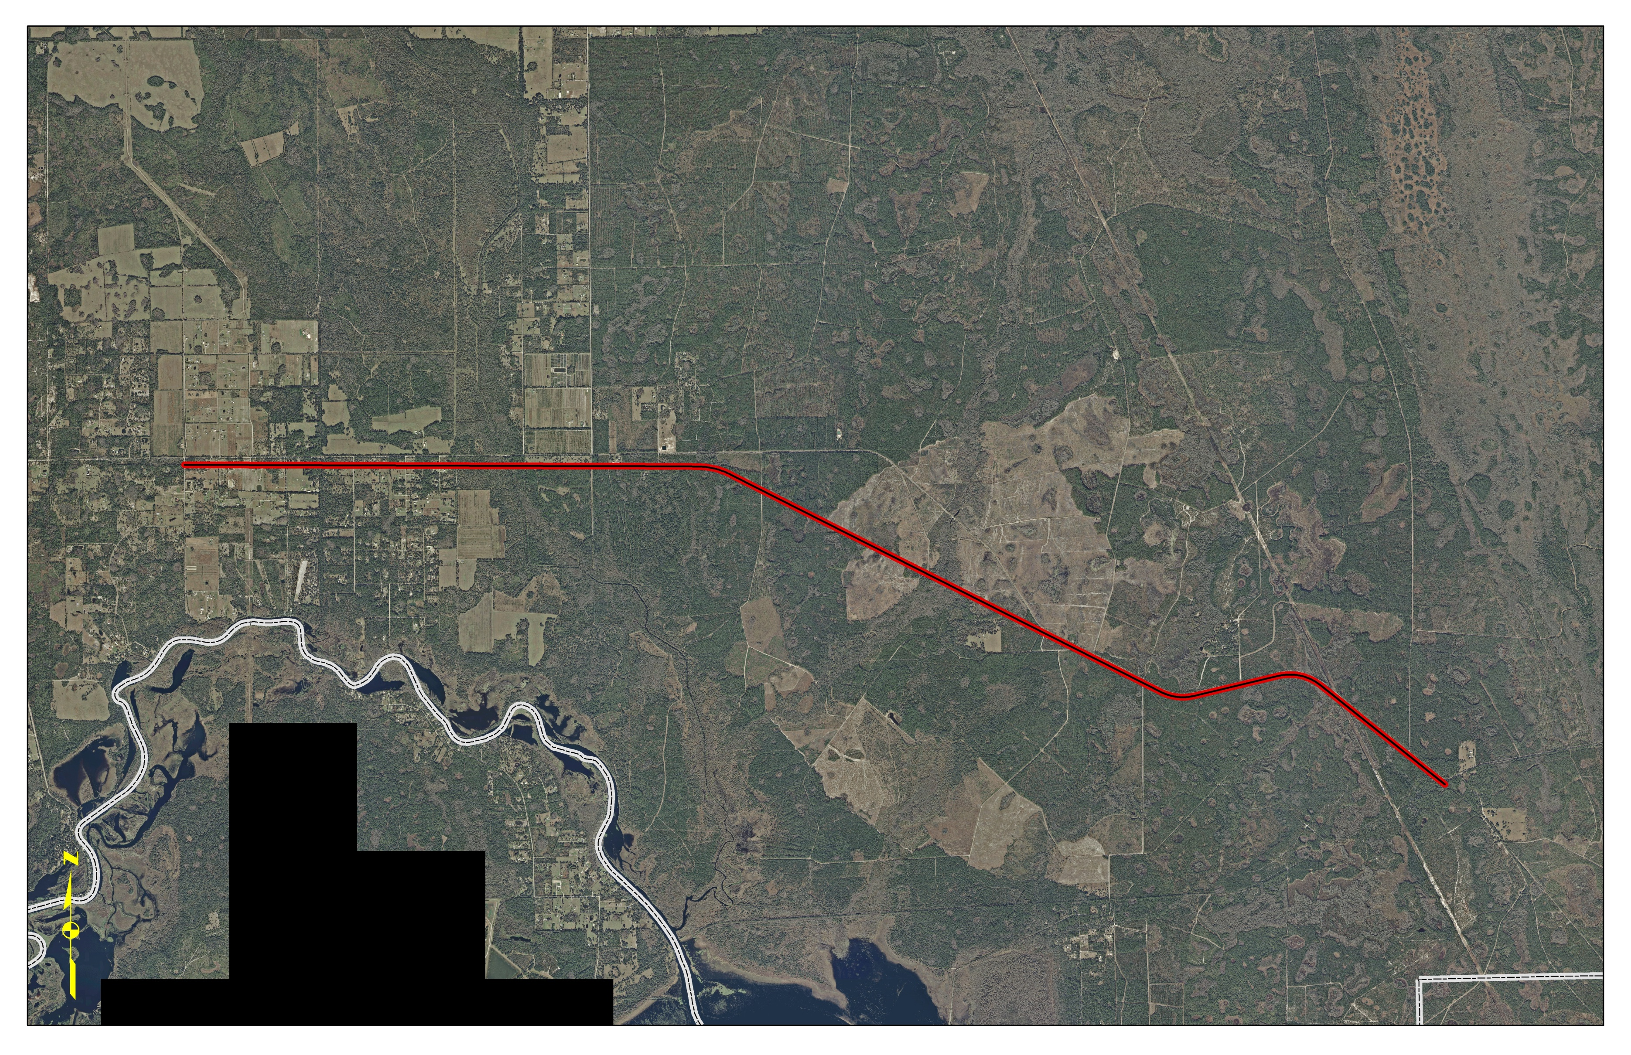
East Central Regional Rail Trail
Osteen Maytown Rd – Guise Rd to Maytown Spur
10 miles – Unfunded
Gobblers Lodge
Trail Head
Pell Rd
Planned
Trail
Osteen
Maytown Rd
Deep Creek
Kayak Launch
Seminole
Volusia
Lake Harney Rd
Planned
Trail
Brevard
Volusia

Slide 9
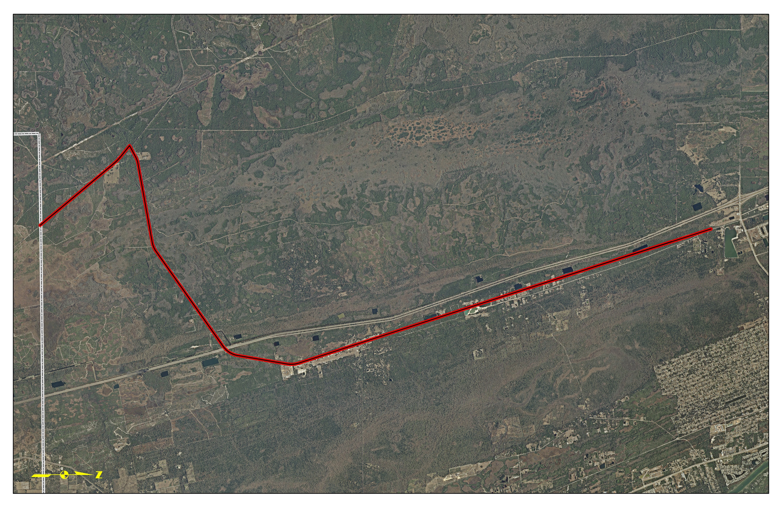
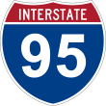
East Central Regional Rail Trail
Brevard to North of Cow Creek
13.5 miles– Late 2016
Planned Trail
Planned
Trail
Planned
Trail
442
Cow Creek Rd
Brevard
Volusia

Slide 10
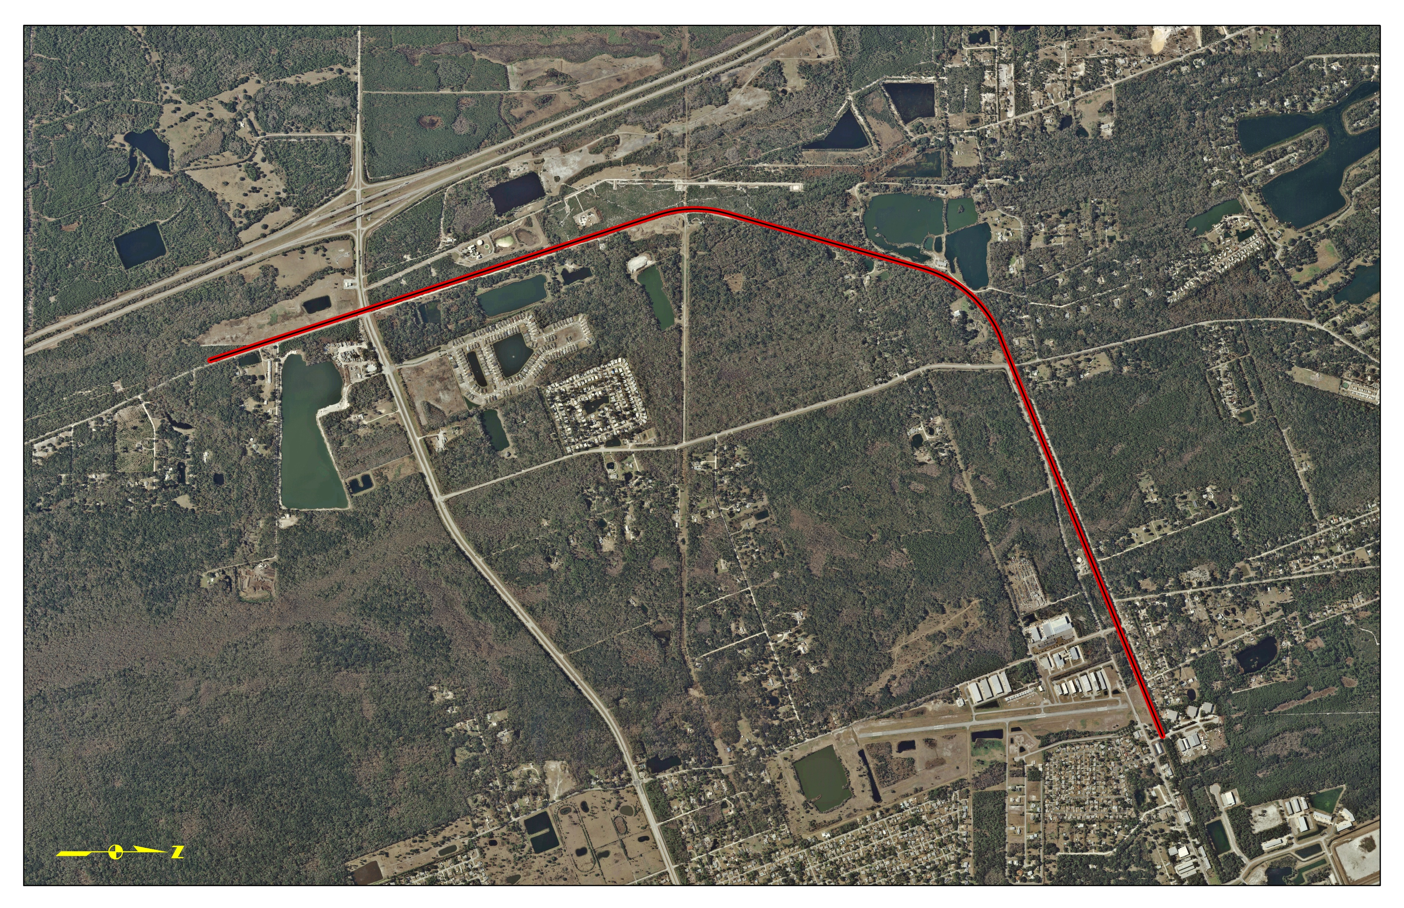
East Central Regional Rail Trail
North of Cow Creek to Dale St
3.8 miles – Late 2014
Planned Trail
Cow Creek Rd
Old Mission Rd
Park Av
442
Dale St
Rotary
Park

